Slide 1
Recurrence Relation & Generating Function
Discrete Math

Slide 2
What is Discrete Mathematics ?
Discrete mathematics is the study of mathematical structures that are countable or otherwise distinct and separable.
Examples of structures that are discrete are combinations, graphs, and logical statements. Discrete structures can be finite or infinite.
Discrete mathematics is in contrast to continuous mathematics, which deals with structures which can range in value over the real numbers, or have some non-separable quality.

Slide 3
Everyday Applications of Discrete Mathematics
Computers
The software and files are both stored as huge strings of 1s and 0s. Binary math is discrete mathematics.
Google Maps
It uses discrete mathematics to determine fastest driving routes and times.
Cryptography
Encryption and decryption are part of cryptography, which is part of discrete mathematics. For example, secure internet shopping uses public-key cryptography.
Digital image processing
It uses discrete mathematics to merge images or apply filters.

Slide 4

Tower of Hanoi
The objective of the puzzle is to move entire stack to another rod obeying the following rules :
Only one disk may move at a time.
Each move consists of taking upper disk from one of the rods & sliding it onto another rod, on top of the other disks that may already be present on that rod.
No disk may be placed on top of a smaller disk.

Slide 5

Tower of Hanoi
Step 1 − Move n-1 disks from source to aux
Step 2 − Move n^{th} disk from source to dest
Step 3 − Move n-1 disks from aux to dest
-------------------------------------------------------------
|Total Number of moves needed to solve for | | given ‘N’ disks : 2^{n} − 1 |
| |
------------------------------------------------------------
Source Auxiliary Destination

Slide 6
Fibonacci Problem:
A farmer raises rabbits. Each rabbit gives birth when 2 months old and then each month there after.
Question: How many rabbits will the farmer have after n months? Try it on small numbers.
Fn ... the number of rabbits after n month. Each rabbit alive the n-1th month remains nth month. Each rabbit alive the n − 2th month adds one more rabbit to nth month.
F1 = 1 F2 = 1 Fn+1 = Fn + Fn−1 if n ≥ 2

Slide 7
. . . Fibonacci Problem :
This formula is an example of a recurrence formula (as opposite to an explicit formula).
Recurrence formulas are often easy to obtain (and easy to code). Often we extend the sequence by starting, F0 = 0, F1 = 0, F2 = 1 Fn+1 = Fn + Fn−1 if n ≥ 1
Sequence of Fibonacci numbers 0, 1, 1, 2, 3, 5, 8, 13, 21, 34, 55, 89, 144, 233, . .
For that reason, Fibonacci numbers have been studied in detail. Some basic identities: F0 + F1 + F2 + · · · + Fn = Fn+2 − 1 F1 + F3 + F5 + · · · + F2n−1 = F2n F0 − F1 + F2 − F3 + · · · − F2n−1 + F2n = F2n−1 − 1 Fn−1Fn+1 − F 2 n = (−1)n

Slide 8
Recurrence relations
A recurrence relation is an equation that recursively defines a sequence where the next term is a function of the previous terms (Expressing Fn as some combination of Fi with i<n).
Example − Fibonacci series − Fn=Fn−1+Fn−2Fn, Tower of Hanoi − Fn=2Fn−1

Slide 9
Types of recurrence relations
First order Recurrence relation :- A recurrence relation of the form : a_{n} = ca_{n-1} + f(n) for n>=1 where c is a constant and f(n) is a known function is called linear recurrence relation of first order with constant coefficient. If f(n) = 0, the relation is homogeneous otherwise non-homogeneous.
Example :- x_{n} = 2x_{n-1} – 1, a_{n} = na_{n-1} + 1, etc.

Slide 10
Backtracking Method
Example:- an=an-1 +3 , a1=2
Then an-1 = an-2 +3
an-2 = an-3 +3
an-3 = an-4 +3 and so on.
Therefore,
an=an-1 +3
=(an-2 +3 )+3 =an-2 +2*3
=(an-3 +3)+6 =an-3 +3*3 . . . .
=a1+(n-1)*3.
The first method is called backtracking, and consists of taking a linear recurrence defining an, and replace the terms an-1,an-2,... with the relation that defines an, but where n is replaced by n - 1, n - 2, etc.
So,
an =2+(n-1)*3

Slide 11
Second order liner homogenous recurrence relation
Definition:
A recurrence relation of the form Ba_{n} + Ca_{n-1} + Da_{n-2} = 0 ——> (1)
is called a second order linear homogeneous recurrence relation with constant coefficients. Solution to this is in form a_{n} = r^{n} where r!=0 Putting this in (1) Br^{n} + Cr^{n-1} + Dr^{n-2} = 0 r² + r + 1 = 0 —–> (2)
Thus, a_{n} = r^{n} is solution of (1) if r satisfies quadratic equation (2). This equation is called characteristic equation for relation (1).

Slide 12
Various Cases
Real and Distinct roots
3 cases
Complex roots
Repeated Real Roots

Slide 13
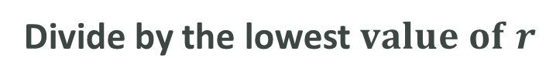

Procedure to solve:
Given equation
Change the given equation $a_{n}$ into $r^{n}$
Divide by the lowest $value of r$
Quadric equation
Find the two roots r1 , r2
Solve

Slide 14
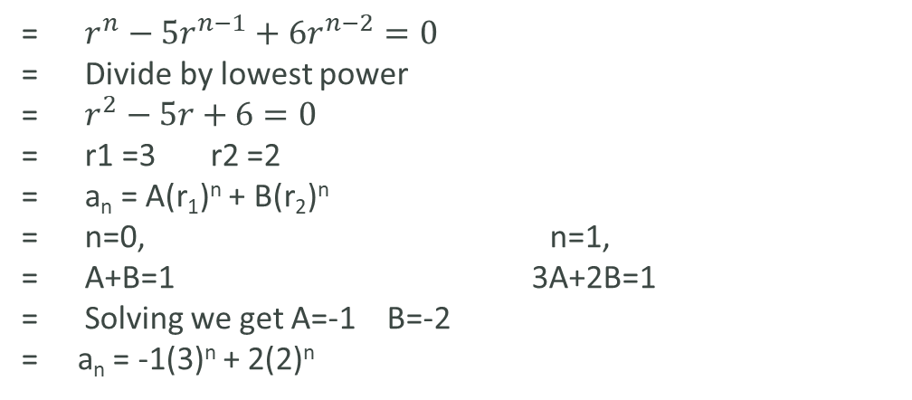
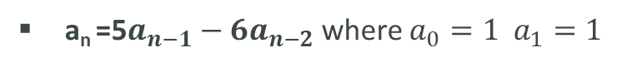
Case 1: Roots are Real & Distinct
If the two roots k₁, k₂ of equation are real and distinct then, we take a_{n} = A(k₁)^{n} + B(k₂)^{n}
as general solution of (1) where A and B are arbitrary real constants.
Problem :
a_{n} =5$a_{n−1}−6a_{n−2}$ where $a_{0}=1 a_{1}=1$
= $r^{n}−{5r}^{n−1}+{6r}^{n−2}=0$
= Divide by lowest power
= $r^{2}−5r+6=0$
= r1 =3 r2 =2
= a_{n} = A(r₁)^{n} + B(r₂)^{n}
= n=0, n=1,
= A+B=1 3A+2B=1
= Solving we get A=-1 B=-2
= a_{n} = -1(3)^{n} + 2(2)^{n}

Slide 15
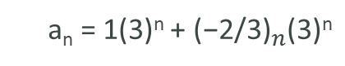
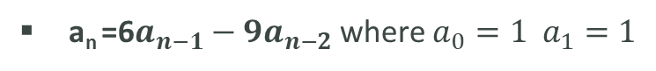
Case 2: Roots are Real & Equal
If the two roots k₁, k₂ of equation are real and equal, with k as common value then, we take a_{n} = (A + Bn)k^{n}
as general solution of (1) where A and B are arbitrary real constants.
Problem:
a_{n} =6$a_{n−1}−9a_{n−2}$ where $a_{0}=1 a_{1}=1$
a_{n} = 1(3)^{n} + ${\text{(−2/}\text{3}\text{)}}_{n}$(3)^{n}
Ans =

Slide 16
Case 3: Roots are Complex
If the two roots k₁ and k₂ of equation are complex then, k₁ and k₂ are complex conjugate of each other i.e k₁ = p + iq and k₂ = p – iq and we take
a_{n} = r^{n}(Acosnθ + Bsinnθ)
as general solution of (1) where A and B are arbitrary complex constants, r = |k₁| = |k₂| = √p² + q² and θ = tan⁻¹(q/p).

Slide 17
Generating Function
Working with a continuous function is sometimes much easier than working with a sequence. For example, in the analysis of functions, calculus is very useful. However, the discrete nature of sequences prevents us from using calculus on sequences. A generating function is a continuous function associated with a given sequence. For this reason, generating functions are very useful in analyzing discrete problems involving sequences of numbers or sequences of functions.

Slide 18
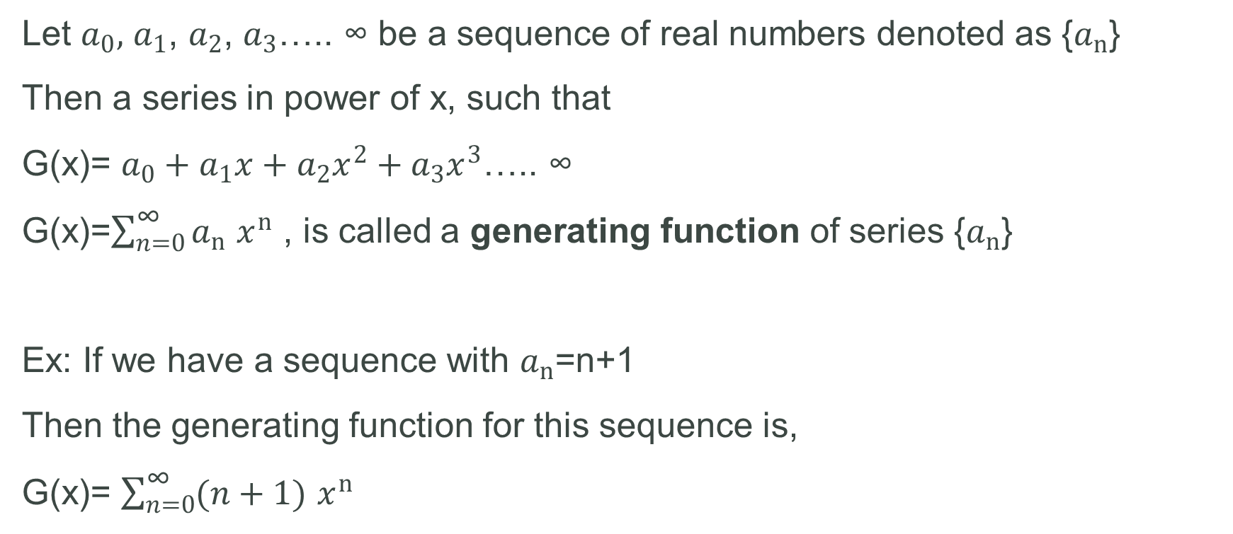
Definition
Let $a_{0},$ $a_{1}$, $a_{2}$, $a_{3}$….. ∞ be a sequence of real numbers denoted as {$a_{n}$}
Then a series in power of x, such that
G(x)= $a_{0}+a_{1}x+a_{2}x^{2}+a_{3}x^{3}\text{….. }\text{∞}$
G(x)=$\sum_{n=0}^{\text{∞}}{a_{n}}$ $x^{n}$ , is called a generating function of series {$a_{n}$}
Ex: If we have a sequence with $a_{n}$=n+1
Then the generating function for this sequence is,
G(x)= $\sum_{n=0}^{\text{∞}}{(n+1)}$ $x^{n}$

Slide 19
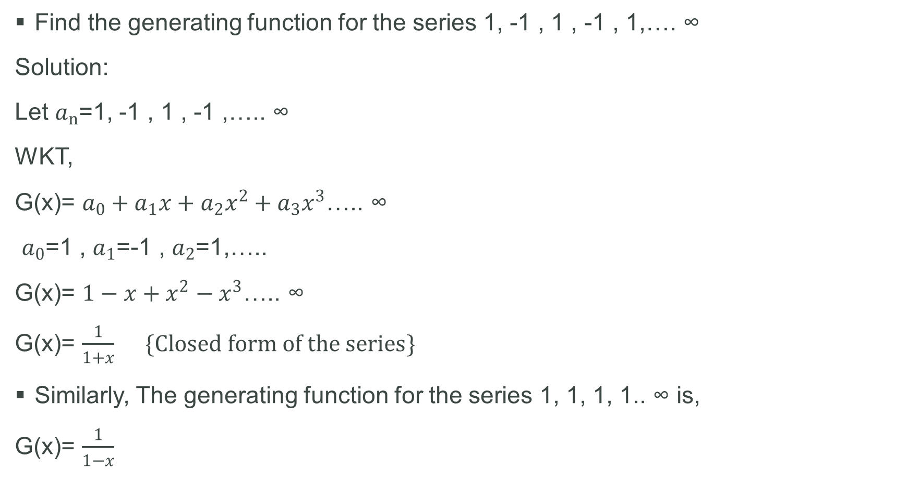
Find the generating function for the series 1, -1 , 1 , -1 , 1,…. $\text{∞}$
Solution:
Let $a_{n}$=1, -1 , 1 , -1 ,….. $\text{∞}$
WKT,
G(x)= $a_{0}+a_{1}x+a_{2}x^{2}+a_{3}x^{3}\text{….. }\text{∞}$
$a_{0}$=1 , $a_{1}$=-1 , $a_{2}$=1,…..
G(x)= $1−x+x^{2}−x^{3}\text{….. }\text{∞}$
G(x)= $\frac{1}{1+x} \{Closed form of the series\}$
Similarly, The generating function for the series 1, 1, 1, 1.. $\text{∞}$ is,
G(x)= $\frac{1}{1−x}$

Slide 20
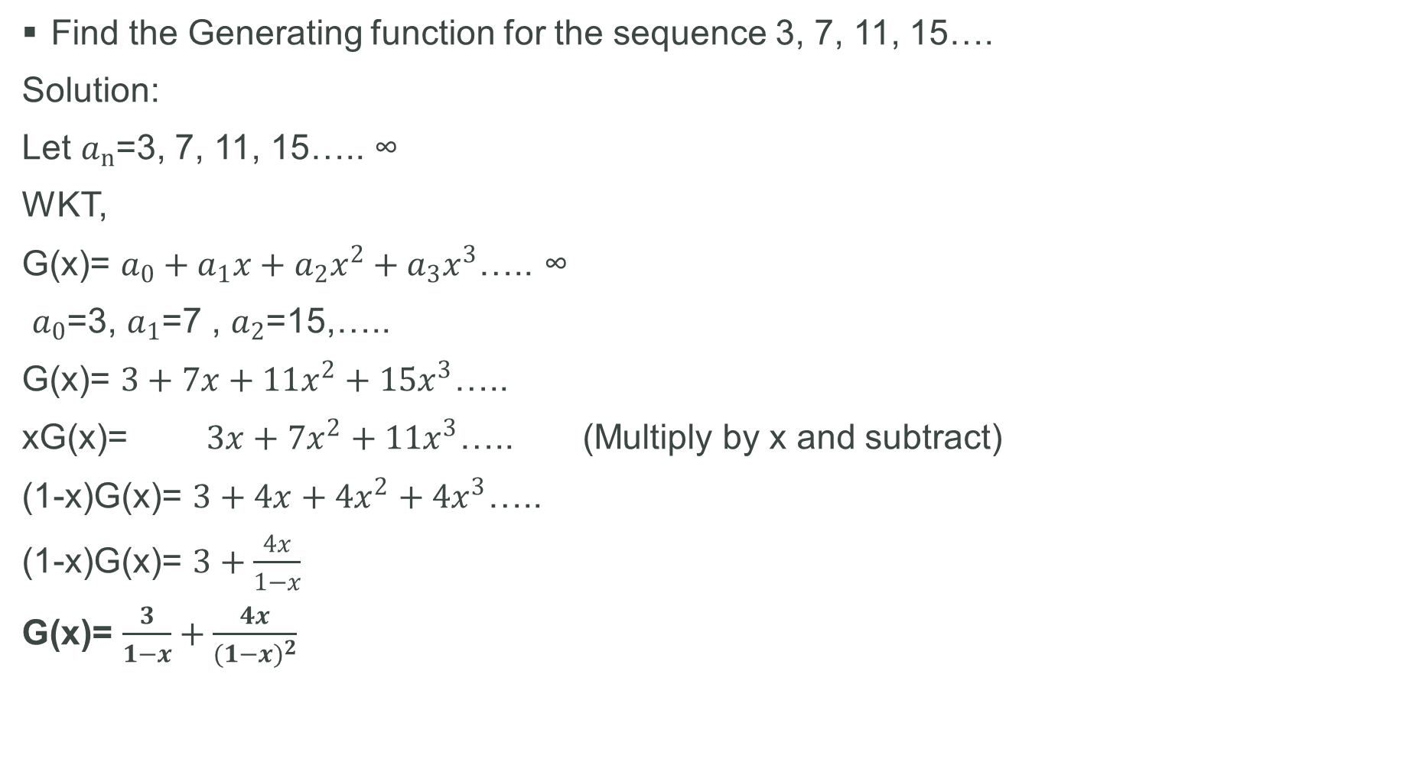
Find the Generating function for the sequence 3, 7, 11, 15….
Solution:
Let $a_{n}$=3, 7, 11, 15….. $\text{∞}$
WKT,
G(x)= $a_{0}+a_{1}x+a_{2}x^{2}+a_{3}x^{3}\text{….. }\text{∞}$
$a_{0}$=3, $a_{1}$=7 , $a_{2}$=15,…..
G(x)= $3+7x+11x^{2}+15x^{3}\text{….. }$
xG(x)= $3x+7x^{2}+11x^{3}\text{….. }$ (Multiply by x and subtract)
(1-x)G(x)= $3+4x+4x^{2}+4x^{3}\text{….. }$
(1-x)G(x)= $3+\frac{4x}{1−x}$
G(x)= $\frac{3}{1−x}+\frac{4x}{{(1−x)}^{2}}$

Slide 21
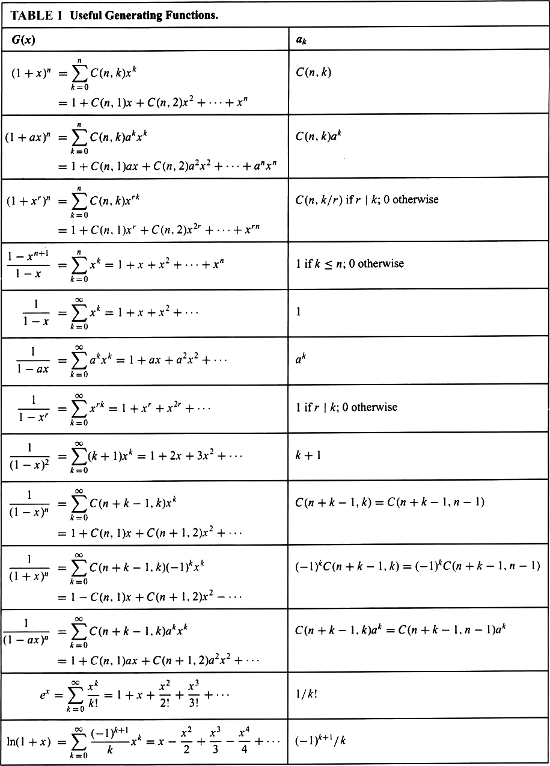

Slide 22
Solving Recurrence Relation Using Generating function
Generating function can be used to solve recurrence relation
Procedure :
Translate a recurrence relation for the terms of a sequence into an equation involving generating function
This equation can be solved to find a closed form of the generating function
From this closed form, the coefficients of the power series for the generating function can be found solving the original recurrence relation

Slide 23
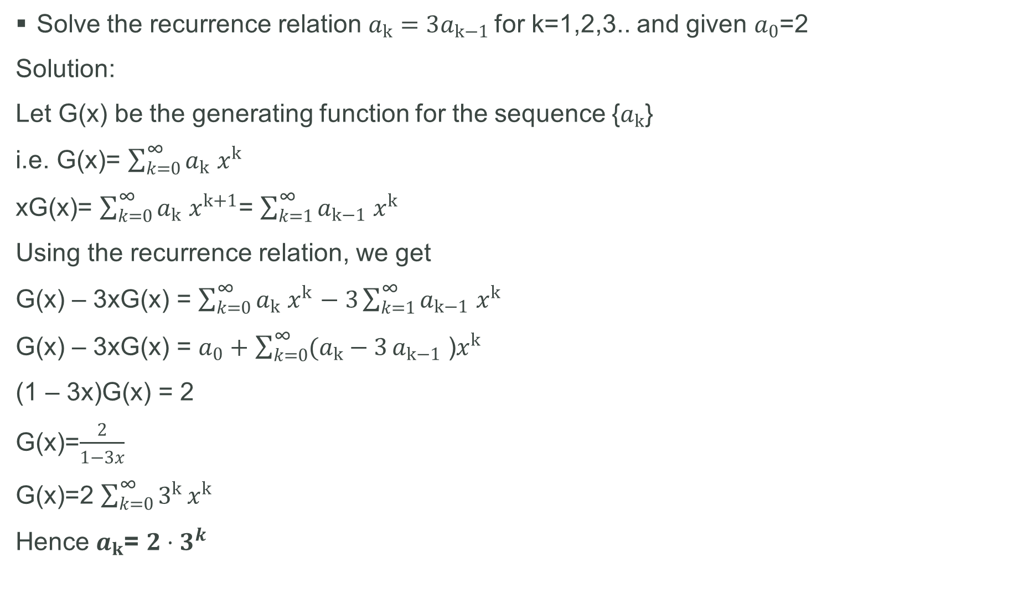
Solve the recurrence relation $a_{k}=3a_{k−1}$for k=1,2,3.. and given $a_{0}$=2
Solution:
Let G(x) be the generating function for the sequence {$a_{k}$}
i.e. G(x)= $\sum_{k=0}^{\text{∞}}{a_{k}}$ $x^{k}$
xG(x)= $\sum_{k=0}^{\text{∞}}{a_{k}}$ $x^{k+1}$= $\sum_{k=1}^{\text{∞}}{a_{k−1}}$ $x^{k}$
Using the recurrence relation, we get
G(x) – 3xG(x) = $\sum_{k=0}^{\text{∞}}{a_{k}}$ $x^{k}$ $− 3\sum_{k=1}^{\text{∞}}{a_{k−1}}$ $x^{k}$
G(x) – 3xG(x) = $a_{0}+$ $\sum_{k=0}^{\text{∞}}{(a_{k}−3}a_{k−1}$ )$x^{k}$
(1 – 3x)G(x) = 2
G(x)=$\frac{2}{1−3x}$
G(x)=2 $\sum_{k=0}^{\text{∞}}{3^{k}}x^{k}$
Hence $a_{k}$= $2⋅3^{k}$

Slide 24
Applications of Generating function
Generating functions are used in a wide area from statistics to mechanics, from combinations to cryptology, especially in topics involving sequences.
They help us
to find the explicit formula for the general term of a sequence
to find recurrence relations
to compute averages and some other statistical properties
to prove some mathematical identities

Slide 25
THANK YOU
Venkatesh D
K Rahul
Vaishnavi R
Akriti J

Slide 26

Add a Slide Title - 2
ANY
QUESTIONS????

